Slide 1


AI-Powered Market Trend Analysis
Presented by: Harshawardhan S. Kardile,
Under Guidance: Niranjan Sir
Insights into Amazon product trends

Slide 2


AI Market Trend Analysis
Exploring AI methodologies to uncover market trends and enhance product insights for Amazon's marketplace.

Slide 3

Methodology Overview
01
Data Acquisition Techniques and Sources
02
Preprocessing Steps for Clean Data
Rigorous cleaning and validation.
03
Exploratory Data Analysis (EDA) Insights
EDA provided valuable visualizations and patterns.

Slide 4

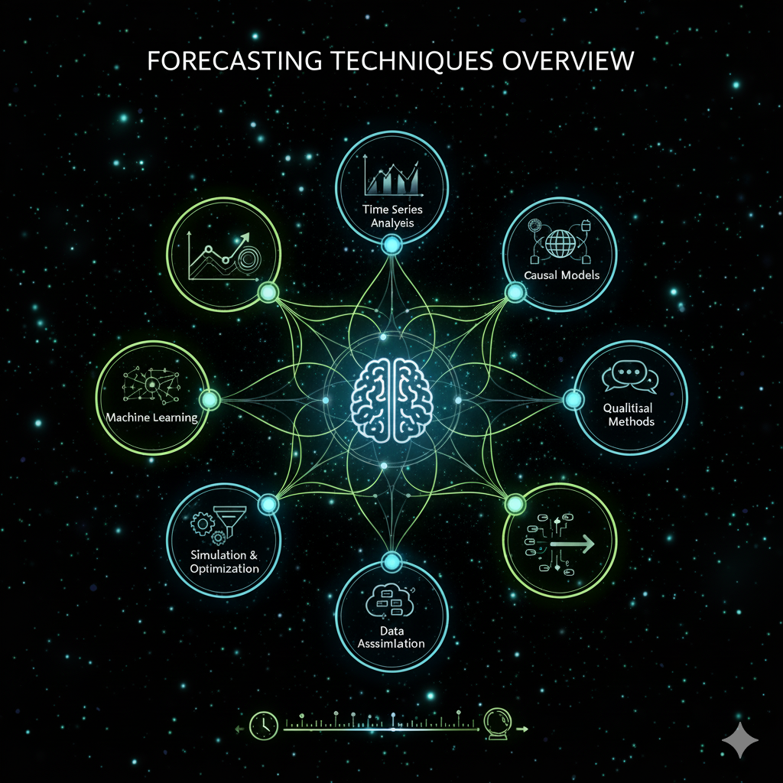
Forecasting Techniques Overview
Prophet Method
Utilizes time series data effectively
Incorporates seasonality and holidays
Provides intuitive parameter tuning options
Multiple Regression
Estimates relationships between variables
Predicts future prices based on trends
Easy to implement and interpret

Slide 5

Key Findings
Sales Trends
Category Performance
Increased sales during holiday seasons and promotions.
Performance varies significantly across different categories.
Seasonal Patterns
Actionable Insights
Sales fluctuate with changing seasons and events.
Focus on high-demand categories during peak seasons.

Slide 6

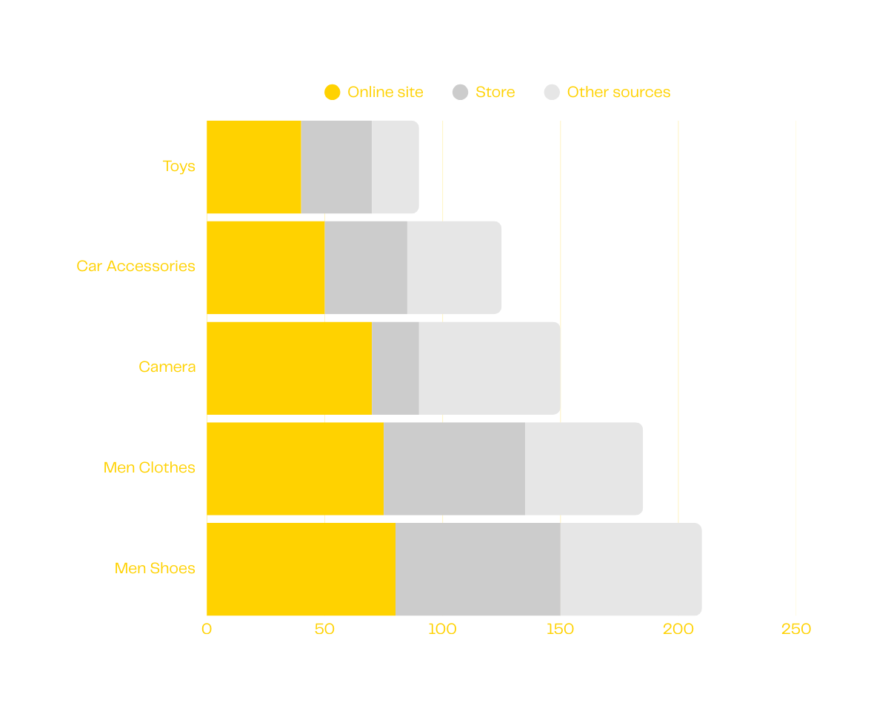
Sales Trends by Product Category
The chart illustrates notable fluctuations in sales across different product categories. Category A consistently leads in sales, while Category C shows seasonal spikes during certain months, indicating shifting consumer preferences.
Comparative sales performance across three product categories

Slide 7



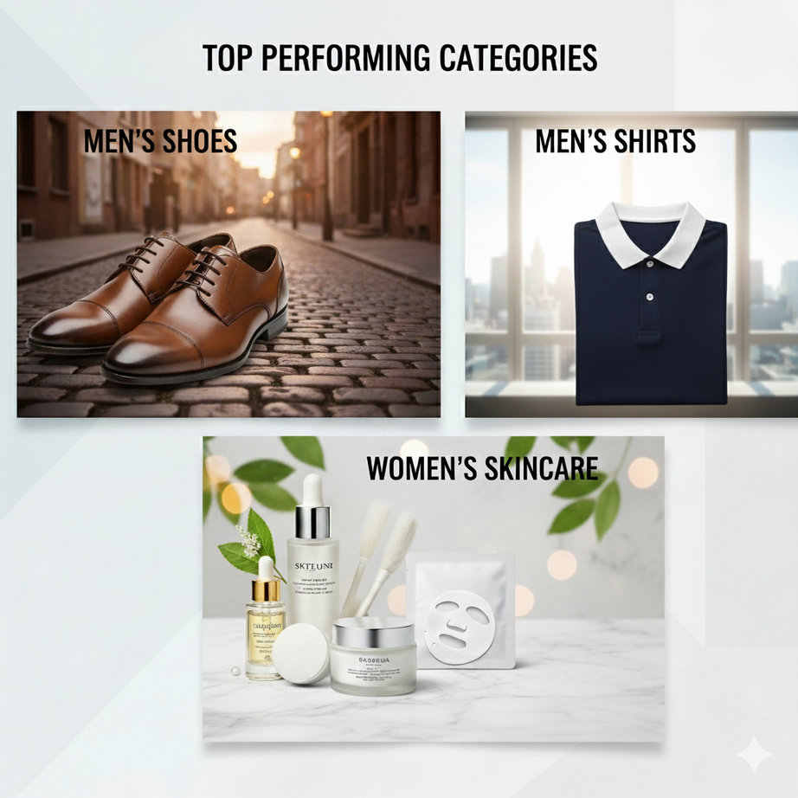
150% Growth
40% Peak
3 Categories
Sales increased dramatically last quarter
Highest sales during September to January season
shoes, shirt, skincare

Slide 8


Thank You!
Student name
Email
Harshawardhan Kardile
harshwardhankardile1990@gmail.com

